Slide 1
第 1 章 Chapter 1
CMOS 反相器
The CMOS Inverter
从一个晶体管开关出发，理解数字芯片的电平、速度与功耗
From one transistor switch to the levels, speed and power of digital chips
数字集成电路设计 Digital Integrated Circuit Design · 问渠 WenQuest
Notes:
开场问题：机器人关节里的电机控制芯片，最基本的单元是什么？它的电平、速度、功耗由什么决定？
Opening question: what is the most basic cell in a robot joint’s motor-control chip, and what sets its levels, speed and power?

Slide 2
本章内容与每节课的结构
Chapter map and how each lesson works
1.1
MOSFET 开关与 CMOS 反相器
MOSFET switches and the CMOS inverter
机器人问题：关节驱动板的光耦输入
Robot: Optocoupler input on a joint driver
1.2
电压传输特性与噪声容限
Voltage transfer characteristic and noise margins
机器人问题：编码器信号的抗干扰
Robot: Noise immunity of an encoder signal
1.3
尺寸与对称
Sizing and symmetry
机器人问题：电机控制芯片的时钟缓冲
Robot: The clock buffer of a motor-control chip
1.4
传播延时与反相器链
Propagation delay and the inverter chain
机器人问题：驱动板上的栅极驱动器
Robot: Driving the gate driver on the board
1.5
功耗
Power
机器人问题：巡线小车控制芯片的功耗预算
Robot: Power budget of a line-following car controller
每节课：实际问题 → 概念 → 动画 → 虚拟实验 → 建模求解 Each lesson: problem → concept → animation → virtual lab → modelling
Notes:
芯片设计同样靠模型：先用简单模型估算，再用仿真和工艺库校准。本章每节从一个机器人问题出发，最后回到这个问题。
Chip design also runs on models: estimate with a simple model, then calibrate with simulation and the process library. Each lesson starts from a robot problem and returns to it.

Slide 3
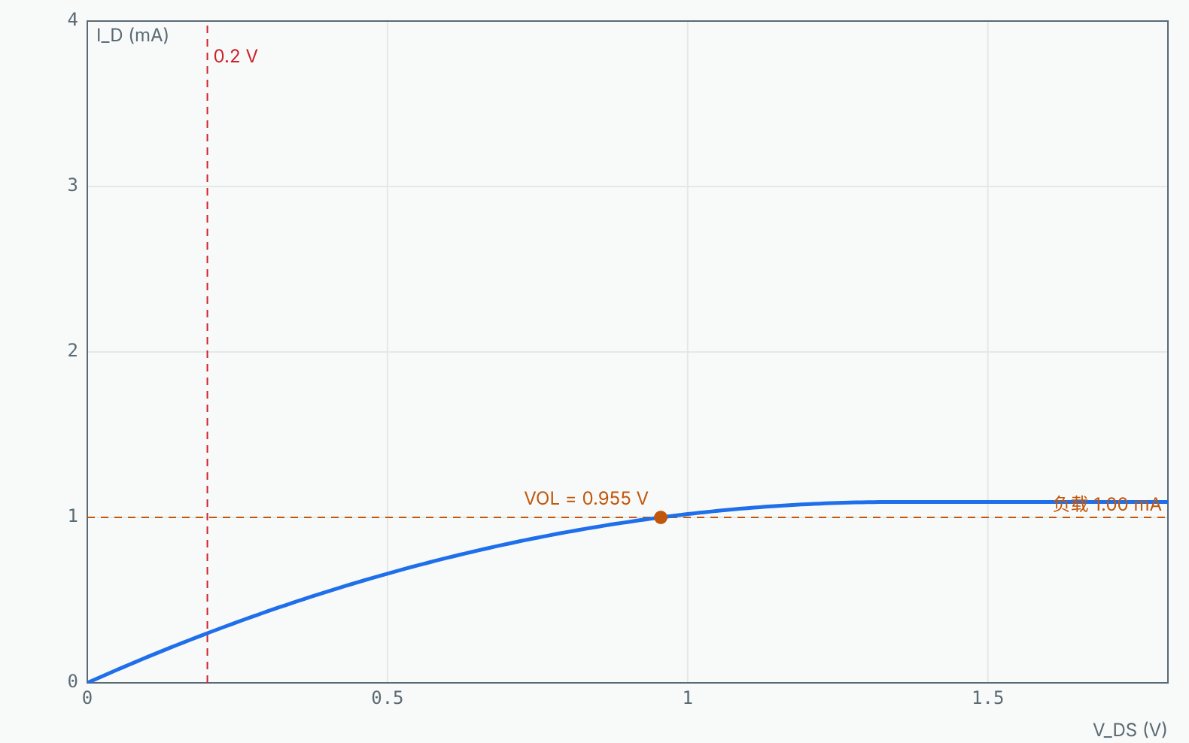
1.1 机器人问题 Robot problem
关节驱动板的光耦输入
Optocoupler input on a joint driver
关节驱动板用光耦隔离控制芯片与功率电路。芯片输出管脚要吸收 1 mA 点亮光耦，低电平不能超过 0.2 V。输出级的 NMOS 至少要多宽？
The joint driver isolates the control chip from the power stage with an optocoupler. The output pin must sink 1 mA with a low level of at most 0.2 V. How wide must the output NMOS be?
已知 Given
负载电流 I = 1 mA
load current I = 1 mA
VOL ≤ 0.2 V，VDD = 1.8 V
VOL ≤ 0.2 V, VDD = 1.8 V
L = 0.15 μm，k′n = 90 μA/V²（示意值）
L = 0.15 μm, k′n = 90 μA/V² (illustrative)
本节结束时，我们用建立的模型回答这个问题。 We will answer it with this lesson’s model at the end.
Notes:
先让学生估一估、讨论 2 分钟，不急于给答案。本节最后回到这一页。
Let students estimate and discuss for two minutes; return to this problem at the end.

Slide 4
1.1 概念 Concept
开关模型与互补结构
Switch model and complementary structure
MOSFET 是电压控制的开关：VGS > VT 导通，VGS < VT 截止
A MOSFET is a voltage-controlled switch: on for VGS > VT, off below
CMOS 反相器：PMOS 上拉、NMOS 下拉，栅极接在一起
CMOS inverter: PMOS pull-up, NMOS pull-down, gates tied together
稳态时总有一个管子截止：没有静态直流通路
One transistor is always off in steady state: no static DC path
导通的管子工作在线性区，相当于电阻 Ron
The on transistor sits in the linear region and acts as a resistor Ron
线性区 ID = k′n(W/L)[(VGS−VT)VDS − VDS²/2]
Ron ≈ 1 / [k′n(W/L)(VDD − VT)]
Notes:
讲清公式中每个量的意义和模型的适用条件，再进入动画。
Explain each quantity and the model’s conditions before the animation.

Slide 5
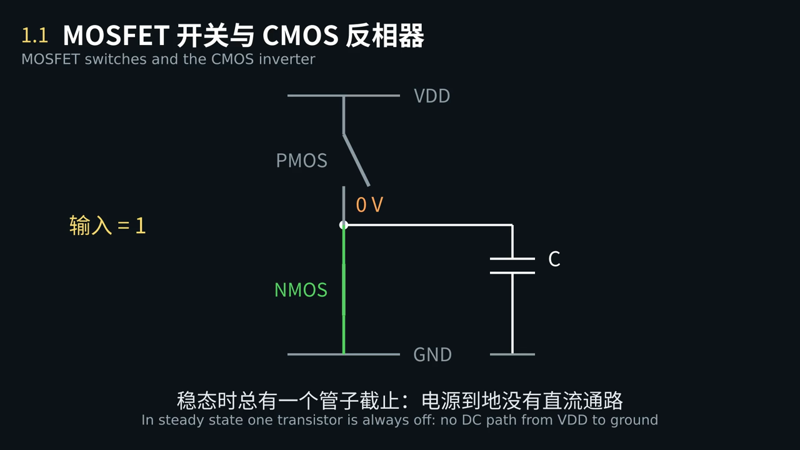
1.1 动画 Animation
输入从 0 变到 1，电流走哪条路？稳态时还有电流吗？
When the input goes from 0 to 1, where does the current flow? Is there any current in steady state?
点击画面播放 · 中英字幕 · Click to play · bilingual captions
Notes:
播放动画，在关键画面暂停提问。
Play the clip and pause at the key frame to ask the question on the slide.

Slide 6
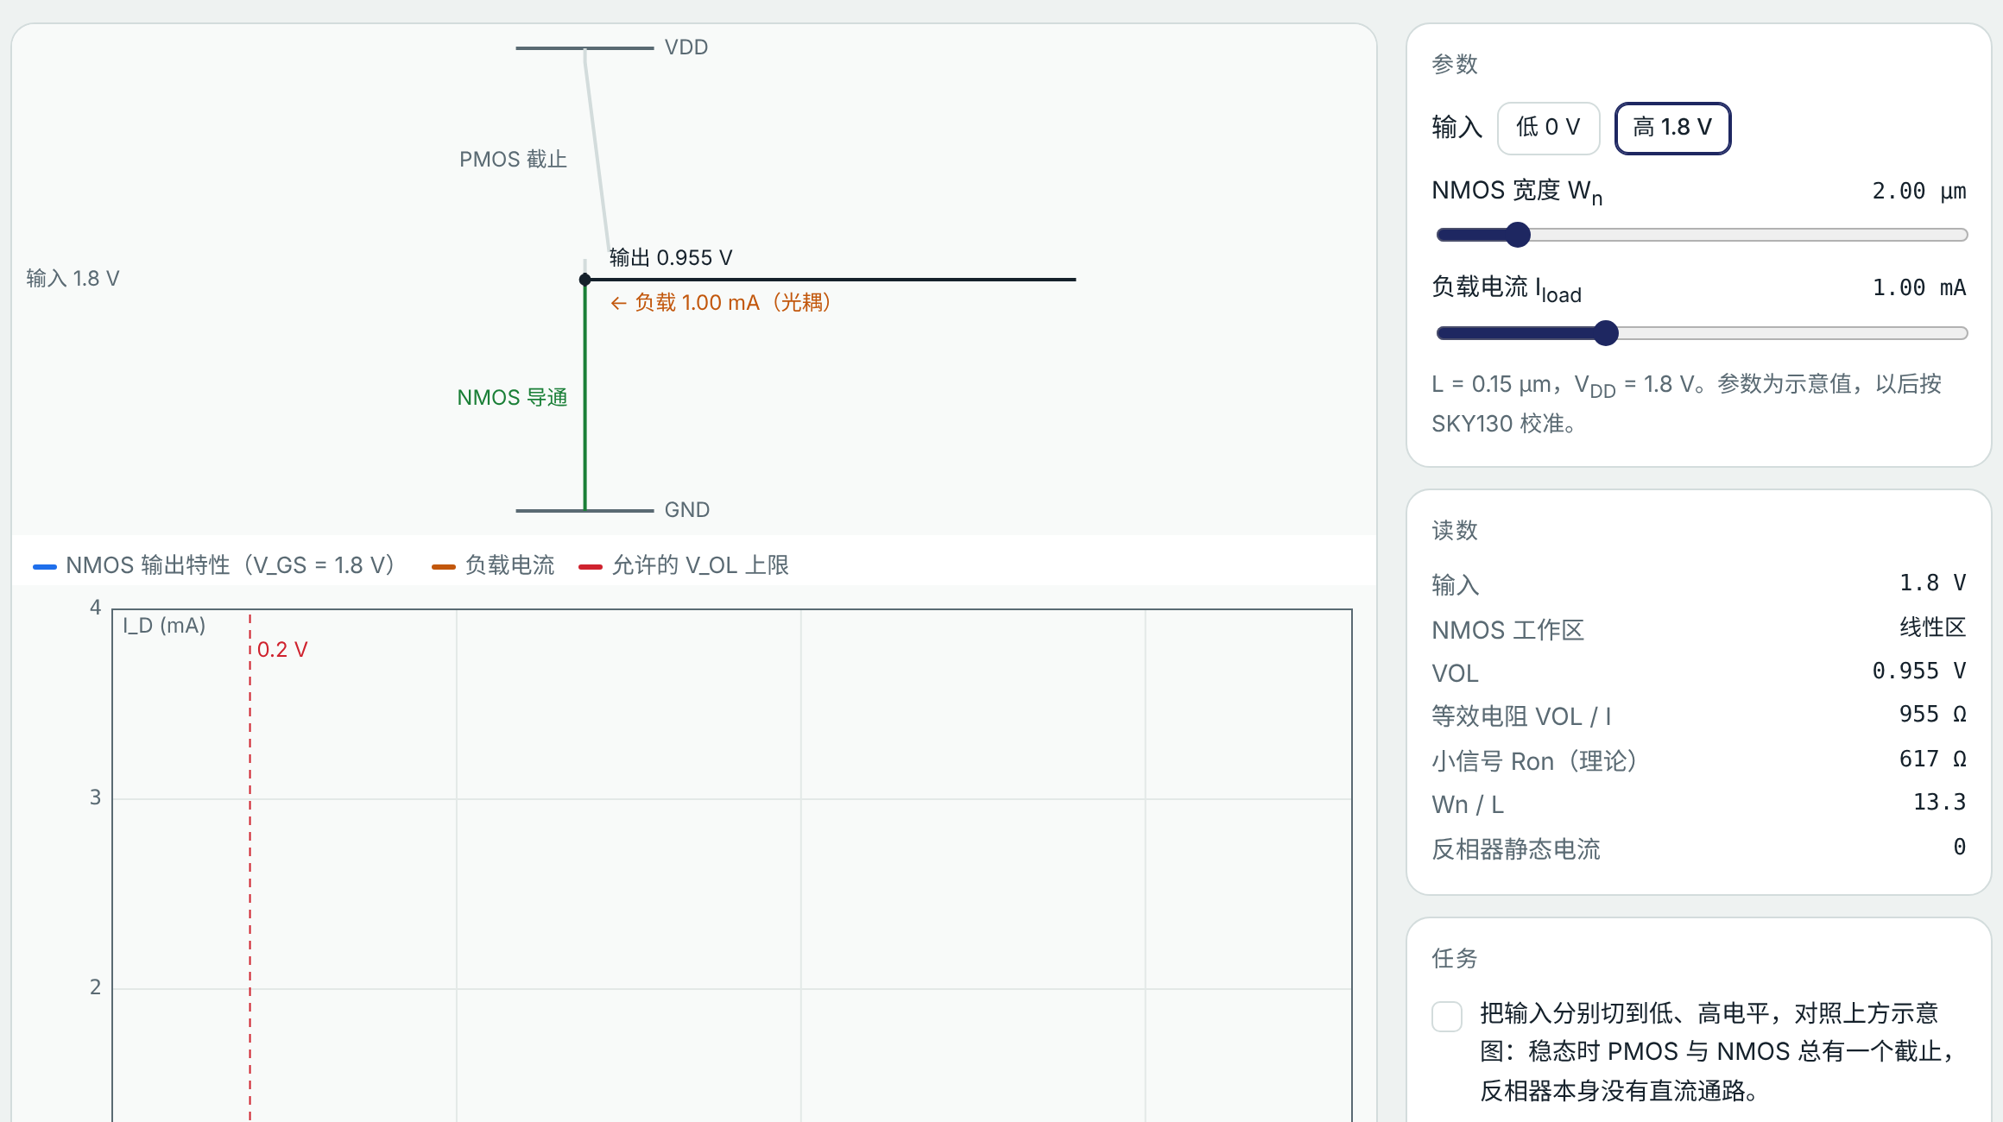
1.1 虚拟实验 Virtual lab
动手试一试：MOSFET 开关与 CMOS 反相器
Try it: MOSFET switches and the CMOS inverter
任务 Tasks
切换输入高低，观察哪个管子导通
Toggle the input and see which transistor conducts
光耦 1 mA：找出 VOL ≤ 0.2 V 的最小 Wn
Optocoupler 1 mA: find the smallest Wn with VOL ≤ 0.2 V
负载加到 2 mA，VOL 正好翻倍吗？
At 2 mA, does VOL exactly double?
打开虚拟实验 Open lab ▶
实验台中选“1.1”选项卡 · 课后按实验指导书完成实验报告
Choose tab 1.1 · write the lab report using the lab guide
Notes:
课堂投屏演示机器人任务，其余任务课后完成，并按实验指导书写实验报告。
Demonstrate the robot task in class; students finish the rest and the lab report after class.

Slide 7
1.1 回到实际问题 Back to the problem
建模求解：关节驱动板的光耦输入
Modelling: Optocoupler input on a joint driver
步骤 Step | 内容 What we do
① 问题 Problem | 关节驱动板用光耦隔离控制芯片与功率电路。芯片输出管脚要吸收 1 mA 点亮光耦，低电平不能超过 0.2 V。输出级的 NMOS 至少要多宽？ The joint driver isolates the control chip from the power stage with an optocoupler. The output pin must sink 1 mA with a low level of at most 0.2 V. How wide must the output NMOS be?
② 建模 Model | 输入为高，NMOS 栅压 1.8 V，工作在线性区；平方律模型，忽略沟道长度调制 Input high, NMOS gate at 1.8 V in the linear region; square law, no channel-length modulation
③ 求解 Solve | W ≥ I·L / {k′n[(VDD−VT)VOL − VOL²/2]} = 6.67 μm（W/L ≈ 44）；2 mA 时 VOL ≈ 0.44 V，不止翻倍 W ≥ I·L / {k′n[(VDD−VT)VOL − VOL²/2]} = 6.67 μm (W/L ≈ 44); at 2 mA VOL ≈ 0.44 V, more than double
④ 检验 Check | 虚拟实验 1.1：负载 1 mA，调 Wn 读 VOL；负载线与输出特性的交点 Lab 1.1: load 1 mA, adjust Wn and read VOL where the load line meets the curve
⑤ 修正 Improve | 实际要按 SKY130 模型和温度、工艺角留余量；电流更大时改用专门的输出驱动或外接三极管 Use SKY130 models with margin for temperature and corners; for larger currents use a dedicated driver or an external transistor
生活中的例子
Everyday example
楼梯间双控开关：两个开关互补，灯只有亮、灭两种状态
Two-way stair switches are complementary: the light is either on or off
芯片设计也靠模型：先用简单模型估算，再用仿真和工艺库校准，最后指出模型的局限。
Chip design runs on models: estimate simply, calibrate with simulation and the process library, then name the limits.
Notes:
对照五步讲解，强调第⑤步：模型在哪里失效。实验报告第六部分按这五步写。数值为示意参数下的结果，以后按 SKY130 校准。
Walk through the five steps, stressing step ⑤. Section 6 of the lab report follows them. Numbers use illustrative parameters, to be calibrated to SKY130.

Slide 8
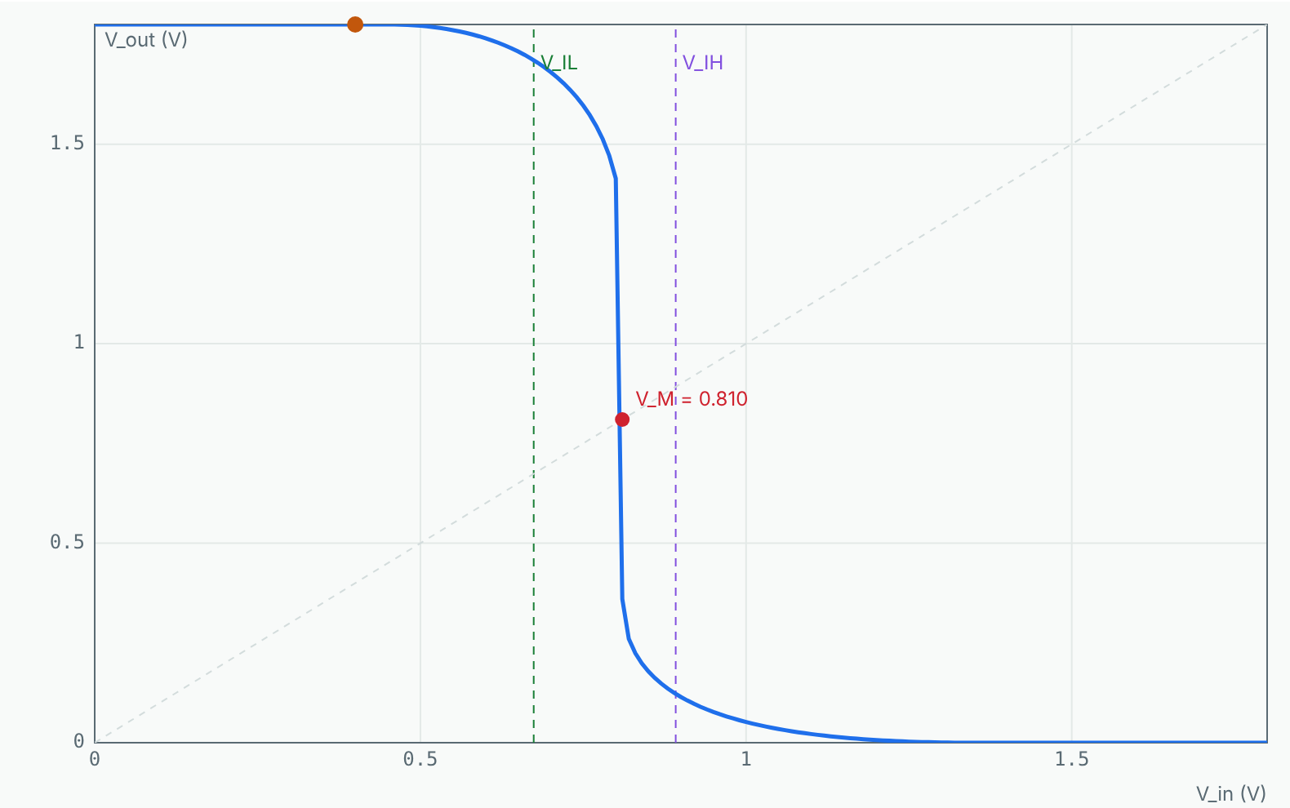
1.2 机器人问题 Robot problem
编码器信号的抗干扰
Noise immunity of an encoder signal
关节编码器的信号经 2 m 电缆进入控制芯片，电机工作时叠加约 ±0.3 V 干扰。接收端的反相器会不会误翻转？
The joint encoder signal travels 2 m of cable into the control chip and picks up about ±0.3 V of motor noise. Will the receiving inverter switch falsely?
已知 Given
干扰幅度 ±0.3 V
noise ±0.3 V
VDD = 1.8 V，|VT| = 0.45 V
VDD = 1.8 V, |VT| = 0.45 V
迁移率比 r = k′n/k′p = 2.25
mobility ratio r = k′n/k′p = 2.25
本节结束时，我们用建立的模型回答这个问题。 We will answer it with this lesson’s model at the end.
Notes:
先让学生估一估、讨论 2 分钟，不急于给答案。本节最后回到这一页。
Let students estimate and discuss for two minutes; return to this problem at the end.

Slide 9
1.2 概念 Concept
传输特性：阈值与噪声容限
Transfer curve: threshold and noise margins
两管电流相等决定输出电压，逐点画出 Vout(Vin)
Equal currents set Vout; plot Vout(Vin) point by point
两管都饱和处曲线最陡：开关阈值 VM
The curve is steepest where both saturate: the threshold VM
斜率为 −1 的两点定出 VIL、VIH
The two slope = −1 points define VIL and VIH
NML = VIL − VOL，NMH = VOH − VIH
NML = VIL − VOL, NMH = VOH − VIH
VM = [VTn + r′(VDD − |VTp|)] / (1 + r′)
r′ = √(k′pWp / k′nWn)
Notes:
讲清公式中每个量的意义和模型的适用条件，再进入动画。
Explain each quantity and the model’s conditions before the animation.

Slide 10
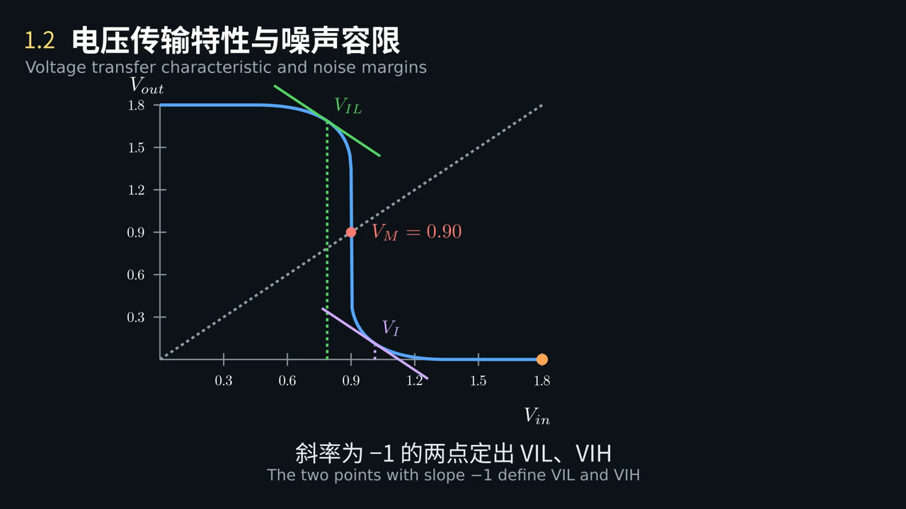
1.2 动画 Animation
输入慢慢增大，两个管子的工作区怎样变化？曲线为什么在中间几乎竖直？
As the input rises, how do the two transistors change region? Why is the curve almost vertical in the middle?
点击画面播放 · 中英字幕 · Click to play · bilingual captions
Notes:
播放动画，在关键画面暂停提问。
Play the clip and pause at the key frame to ask the question on the slide.

Slide 11
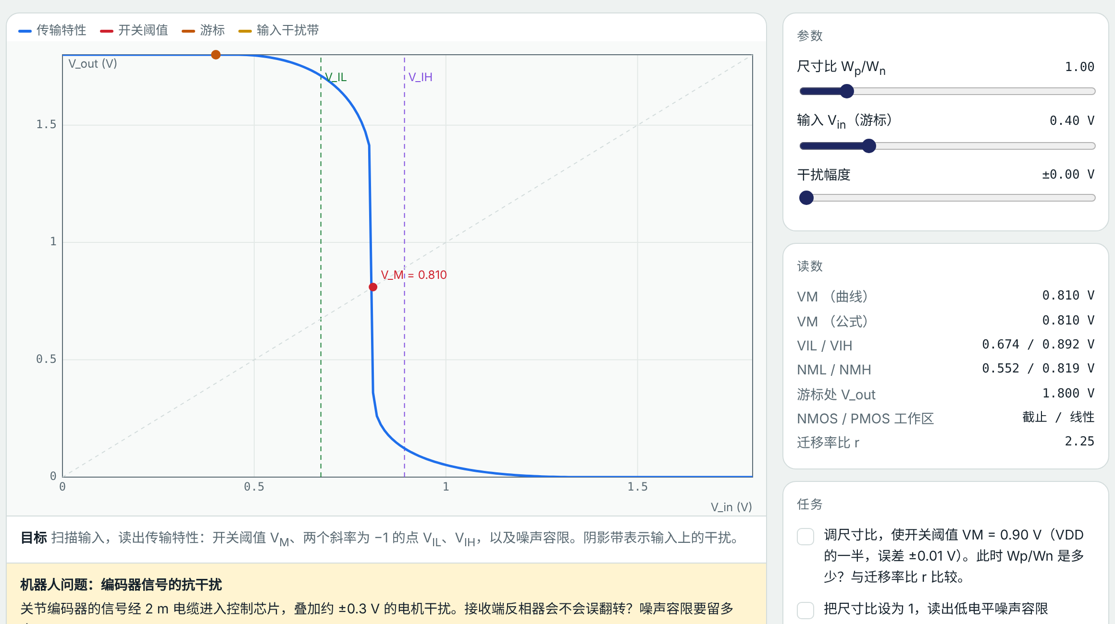
1.2 虚拟实验 Virtual lab
动手试一试：电压传输特性与噪声容限
Try it: Voltage transfer characteristic and noise margins
任务 Tasks
调尺寸比使 VM = 0.90 V
Adjust the ratio until VM = 0.90 V
尺寸比 1：读出 NML
Ratio 1: read NML
干扰 0.30 V：两个容限都 ≥ 0.6 V
Noise 0.30 V: both margins ≥ 0.6 V
打开虚拟实验 Open lab ▶
实验台中选“1.2”选项卡 · 课后按实验指导书完成实验报告
Choose tab 1.2 · write the lab report using the lab guide
Notes:
课堂投屏演示机器人任务，其余任务课后完成，并按实验指导书写实验报告。
Demonstrate the robot task in class; students finish the rest and the lab report after class.

Slide 12
1.2 回到实际问题 Back to the problem
建模求解：编码器信号的抗干扰
Modelling: Noise immunity of an encoder signal
步骤 Step | 内容 What we do
① 问题 Problem | 关节编码器的信号经 2 m 电缆进入控制芯片，电机工作时叠加约 ±0.3 V 干扰。接收端的反相器会不会误翻转？ The joint encoder signal travels 2 m of cable into the control chip and picks up about ±0.3 V of motor noise. Will the receiving inverter switch falsely?
② 建模 Model | 接收端为最小反相器；干扰叠加在输入电平上；容限至少为干扰的 2 倍 The receiver is a minimum inverter; noise adds to the input level; margins should be at least twice the noise
③ 求解 Solve | Wp/Wn = 1：VM ≈ 0.81 V，NML ≈ 0.55、NMH ≈ 0.82 V；Wp/Wn = 2.25：VM = 0.90 V，NML = NMH ≈ 0.67 V Wp/Wn = 1: VM ≈ 0.81 V, NML ≈ 0.55, NMH ≈ 0.82 V; Wp/Wn = 2.25: VM = 0.90 V, NML = NMH ≈ 0.67 V
④ 检验 Check | 虚拟实验 1.2：干扰幅度设为 0.30 V，比较不同尺寸比下的两个容限 Lab 1.2: set the noise to 0.30 V and compare both margins for different ratios
⑤ 修正 Improve | 干扰更大时用施密特触发器（有回差）或差分信号（如 RS-422 编码器接口） For larger noise use a Schmitt trigger (hysteresis) or differential signalling (e.g. an RS-422 encoder interface)
生活中的例子
Everyday example
声控楼道灯的阈值：太低会被杂音触发，太高叫不亮
A sound-activated stair light: too low a threshold triggers on noise, too high won’t respond
芯片设计也靠模型：先用简单模型估算，再用仿真和工艺库校准，最后指出模型的局限。
Chip design runs on models: estimate simply, calibrate with simulation and the process library, then name the limits.
Notes:
对照五步讲解，强调第⑤步：模型在哪里失效。实验报告第六部分按这五步写。数值为示意参数下的结果，以后按 SKY130 校准。
Walk through the five steps, stressing step ⑤. Section 6 of the lab report follows them. Numbers use illustrative parameters, to be calibrated to SKY130.

Slide 13
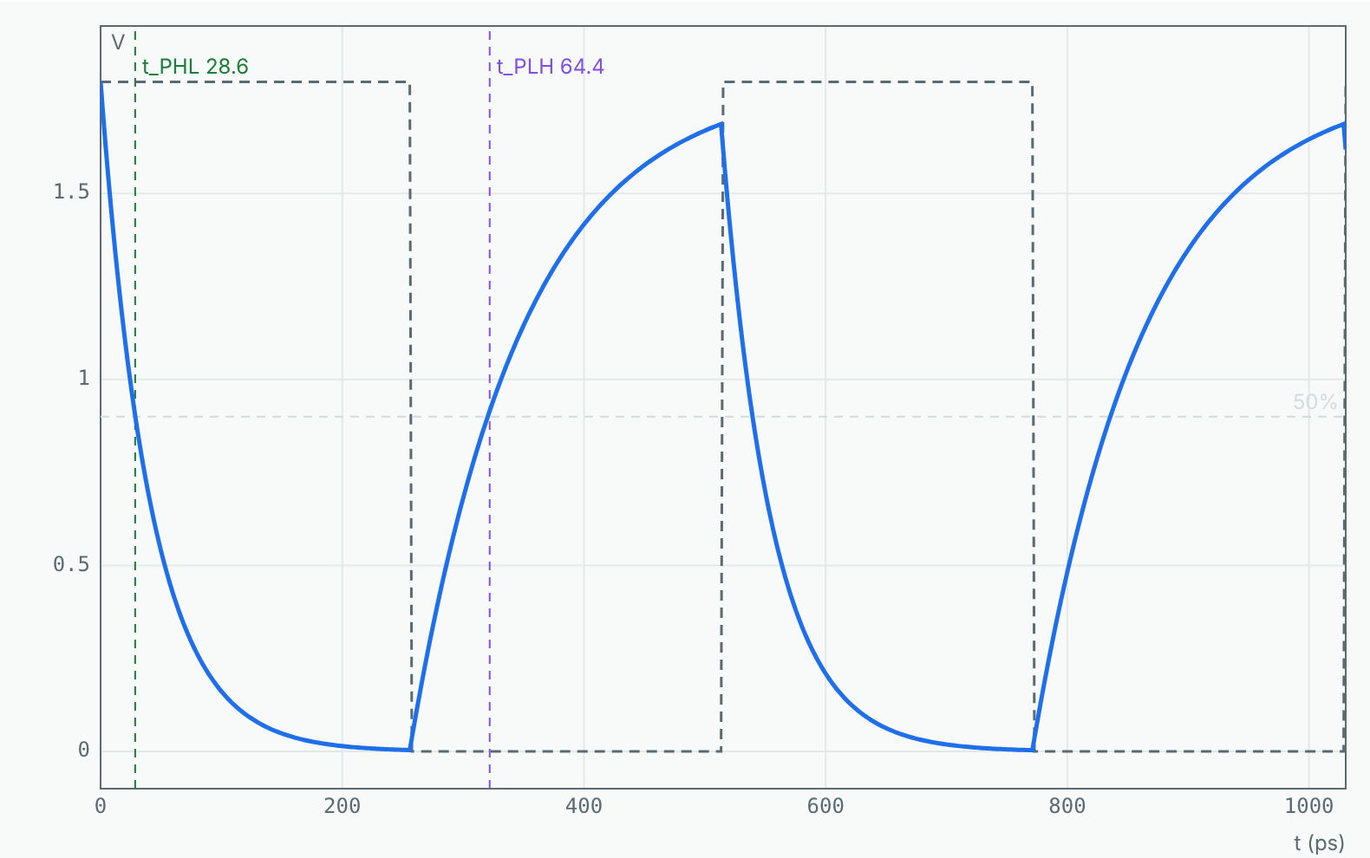
1.3 机器人问题 Robot problem
电机控制芯片的时钟缓冲
The clock buffer of a motor-control chip
电机控制芯片的时钟经缓冲器分发到 PWM 计数器。缓冲器上升、下降延时不同，时钟占空比就会走样。尺寸比怎样取才能让两种延时接近？
The motor-control chip distributes its clock through buffers to the PWM counter. Unequal rise and fall delays distort the duty cycle. Which size ratio matches them?
已知 Given
负载：4 个相同反相器（FO4）
load: four identical inverters (FO4)
Wn = 0.42 μm（最小）
Wn = 0.42 μm (minimum)
Req ≈ ¾·VDD/IDSAT
Req ≈ ¾·VDD/IDSAT
本节结束时，我们用建立的模型回答这个问题。 We will answer it with this lesson’s model at the end.
Notes:
先让学生估一估、讨论 2 分钟，不急于给答案。本节最后回到这一页。
Let students estimate and discuss for two minutes; return to this problem at the end.

Slide 14
1.3 概念 Concept
RC 延时与对称尺寸
RC delay and symmetric sizing
导通管看成等效电阻 Req，负载看成电容 CL
Treat the on transistor as Req and the load as CL
tPHL = 0.69·Req,n·CL，tPLH = 0.69·Req,p·CL
tPHL = 0.69·Req,n·CL, tPLH = 0.69·Req,p·CL
PMOS 迁移率低：同尺寸时 Req,p ≈ 2.25 × Req,n
Lower PMOS mobility: at equal size Req,p ≈ 2.25 × Req,n
Wp/Wn = r：上升下降相等；Wp/Wn ≈ √r：平均延时最小
Wp/Wn = r equalises edges; Wp/Wn ≈ √r minimises average delay
tp = (tPHL + tPLH) / 2 = 0.69 · CL · (Req,n + Req,p) / 2
Notes:
讲清公式中每个量的意义和模型的适用条件，再进入动画。
Explain each quantity and the model’s conditions before the animation.

Slide 15
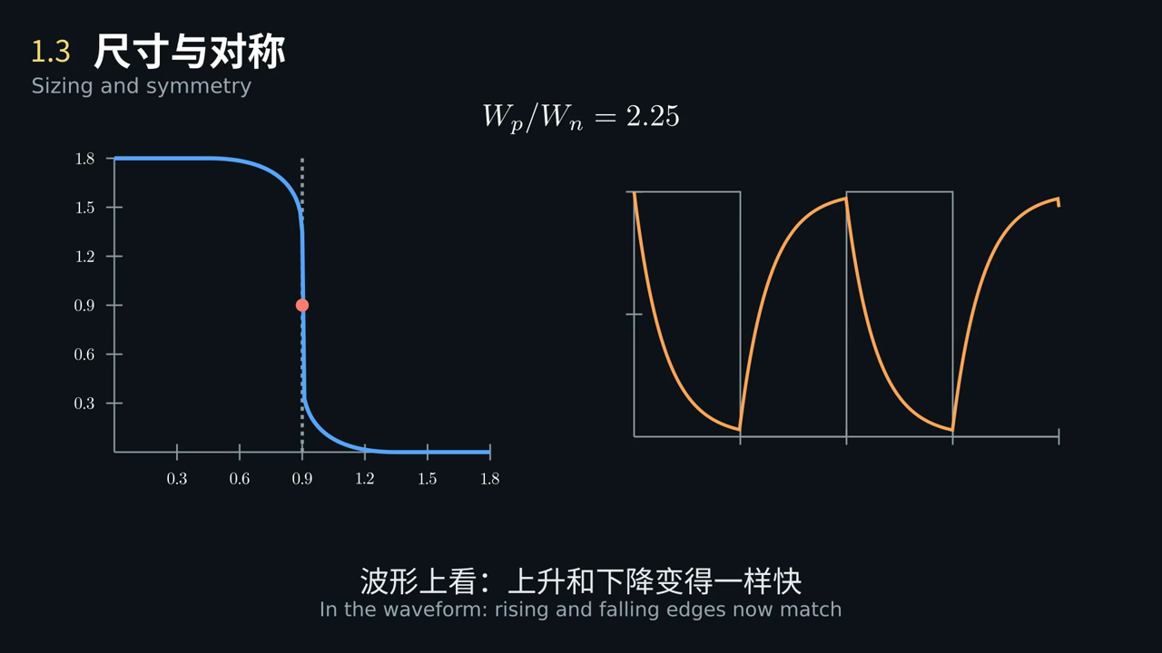
1.3 动画 Animation
加宽 PMOS 以后，传输特性和输出波形各发生了什么变化？
After widening the PMOS, what changes in the transfer curve and the output waveform?
点击画面播放 · 中英字幕 · Click to play · bilingual captions
Notes:
播放动画，在关键画面暂停提问。
Play the clip and pause at the key frame to ask the question on the slide.

Slide 16
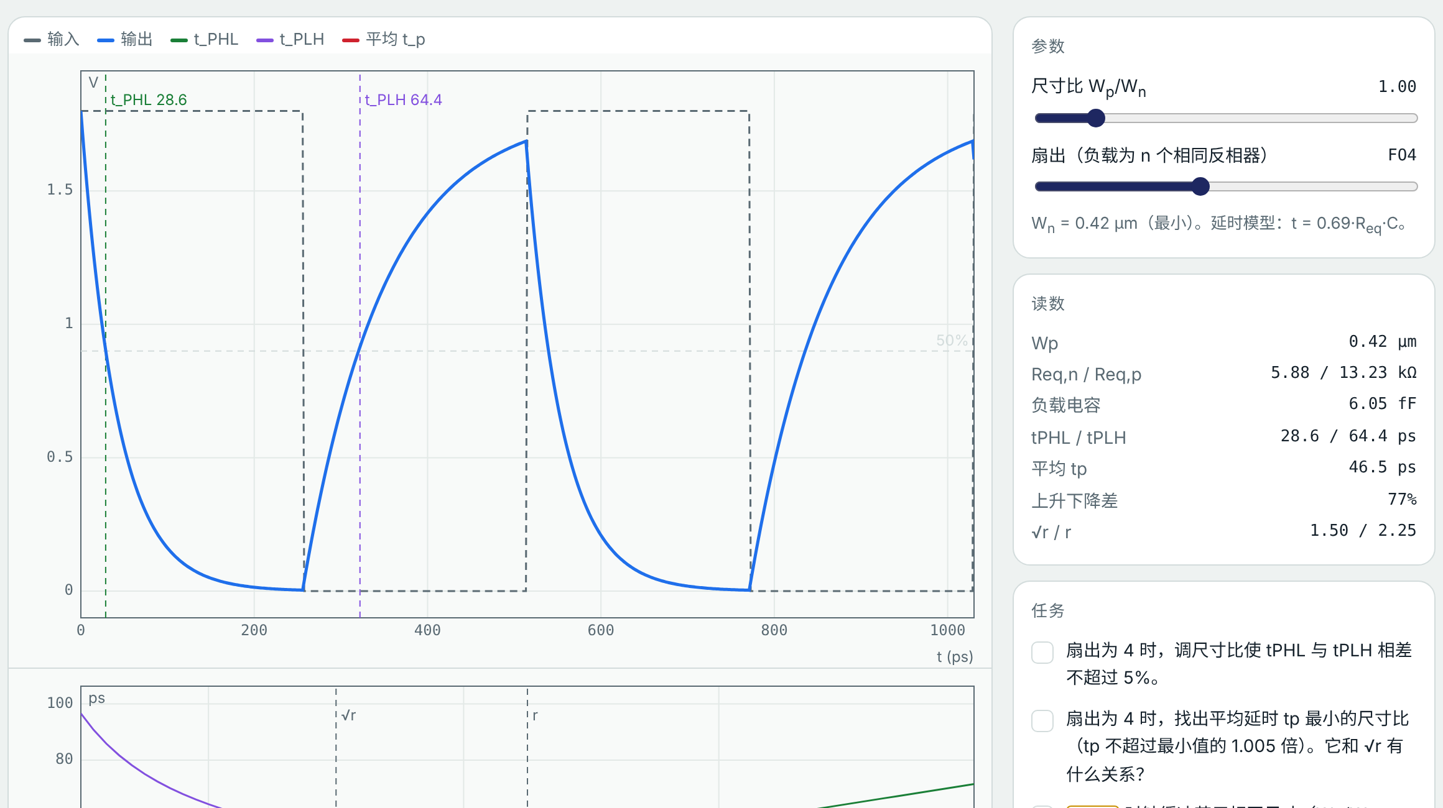
1.3 虚拟实验 Virtual lab
动手试一试：尺寸与对称
Try it: Sizing and symmetry
任务 Tasks
FO4：使上升下降相差 ≤ 5%
FO4: make rise and fall differ by ≤ 5%
FO4：找出平均延时最小的尺寸比
FO4: find the ratio with the smallest average delay
Wp/Wn = 1 时延时差多少？
How large is the mismatch at Wp/Wn = 1?
打开虚拟实验 Open lab ▶
实验台中选“1.3”选项卡 · 课后按实验指导书完成实验报告
Choose tab 1.3 · write the lab report using the lab guide
Notes:
课堂投屏演示机器人任务，其余任务课后完成，并按实验指导书写实验报告。
Demonstrate the robot task in class; students finish the rest and the lab report after class.

Slide 17
1.3 回到实际问题 Back to the problem
建模求解：电机控制芯片的时钟缓冲
Modelling: The clock buffer of a motor-control chip
步骤 Step | 内容 What we do
① 问题 Problem | 电机控制芯片的时钟经缓冲器分发到 PWM 计数器。缓冲器上升、下降延时不同，时钟占空比就会走样。尺寸比怎样取才能让两种延时接近？ The motor-control chip distributes its clock through buffers to the PWM counter. Unequal rise and fall delays distort the duty cycle. Which size ratio matches them?
② 建模 Model | 一阶 RC 模型；负载 = 4 × 输入电容 + 自载；忽略输入边沿斜率 First-order RC model; load = 4 × input capacitance + self-load; input slope ignored
③ 求解 Solve | Wp/Wn = 1：tPHL ≈ 29、tPLH ≈ 64 ps（差 77%）；Wp/Wn = 2.25：两者 ≈ 47 ps；Wp/Wn ≈ 1.50：tp ≈ 45 ps 最小 Wp/Wn = 1: tPHL ≈ 29, tPLH ≈ 64 ps (77% apart); Wp/Wn = 2.25: both ≈ 47 ps; Wp/Wn ≈ 1.50: smallest tp ≈ 45 ps
④ 检验 Check | 虚拟实验 1.3：FO4 下扫描尺寸比，读波形和下方延时曲线 Lab 1.3: sweep the ratio at FO4, read the waveform and the delay plot
⑤ 修正 Improve | 时钟缓冲选对称尺寸；普通逻辑取 √r 附近省面积；实际还要考虑输入斜率和工艺角 Use symmetric sizing for clock buffers and about √r for ordinary logic; real designs also account for input slope and corners
生活中的例子
Everyday example
跷跷板两边体重不同，要挪支点才能平衡
On a seesaw with unequal weights, move the pivot to balance it
芯片设计也靠模型：先用简单模型估算，再用仿真和工艺库校准，最后指出模型的局限。
Chip design runs on models: estimate simply, calibrate with simulation and the process library, then name the limits.
Notes:
对照五步讲解，强调第⑤步：模型在哪里失效。实验报告第六部分按这五步写。数值为示意参数下的结果，以后按 SKY130 校准。
Walk through the five steps, stressing step ⑤. Section 6 of the lab report follows them. Numbers use illustrative parameters, to be calibrated to SKY130.

Slide 18
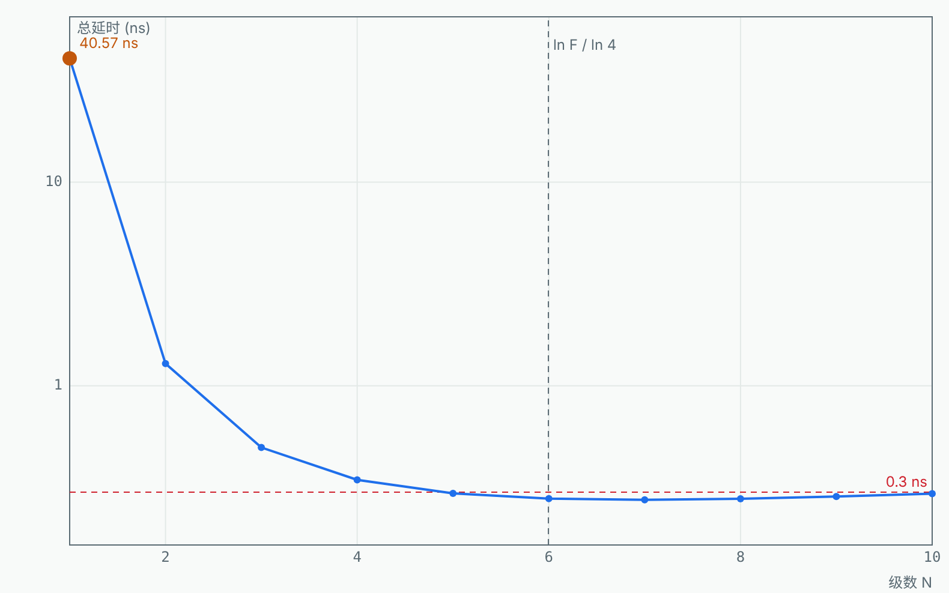
1.4 机器人问题 Robot problem
驱动板上的栅极驱动器
Driving the gate driver on the board
芯片的 PWM 输出要经焊盘、走线驱动电路板上的栅极驱动器输入，总负载约 10 pF。最小反相器直接驱动要几十纳秒，PWM 边沿被拖慢。插几级缓冲最快？
The chip’s PWM output drives pad, trace and gate-driver input, about 10 pF in all. A minimum inverter takes tens of nanoseconds, smearing the PWM edges. How many buffer stages are fastest?
已知 Given
负载 CL = 10 pF
load CL = 10 pF
第一级输入电容 Cin ≈ 2.46 fF
first-stage Cin ≈ 2.46 fF
边沿延时要求 < 0.3 ns
edge delay must be < 0.3 ns
本节结束时，我们用建立的模型回答这个问题。 We will answer it with this lesson’s model at the end.
Notes:
先让学生估一估、讨论 2 分钟，不急于给答案。本节最后回到这一页。
Let students estimate and discuss for two minutes; return to this problem at the end.

Slide 19
1.4 概念 Concept
反相器链：逐级放大
Inverter chain: grow stage by stage
总扇出 F = CL / Cin，N 级等比链每级扇出 f = F^(1/N)
Total fan-out F = CL / Cin; each of N stages has f = F^(1/N)
总延时 t = N · tp0 · (γ + f)，γ 为自载与输入电容之比
Total delay t = N · tp0 · (γ + f), γ = self-load / input capacitance
最优每级扇出约 4（不计自载时为 e ≈ 2.7）
Optimum fan-out about 4 per stage (e ≈ 2.7 without self-load)
级数奇偶决定输出是否反相
An odd or even number of stages decides whether the output is inverted
N ≈ ln F / ln 4 f = F^(1/N)
Notes:
讲清公式中每个量的意义和模型的适用条件，再进入动画。
Explain each quantity and the model’s conditions before the animation.

Slide 20
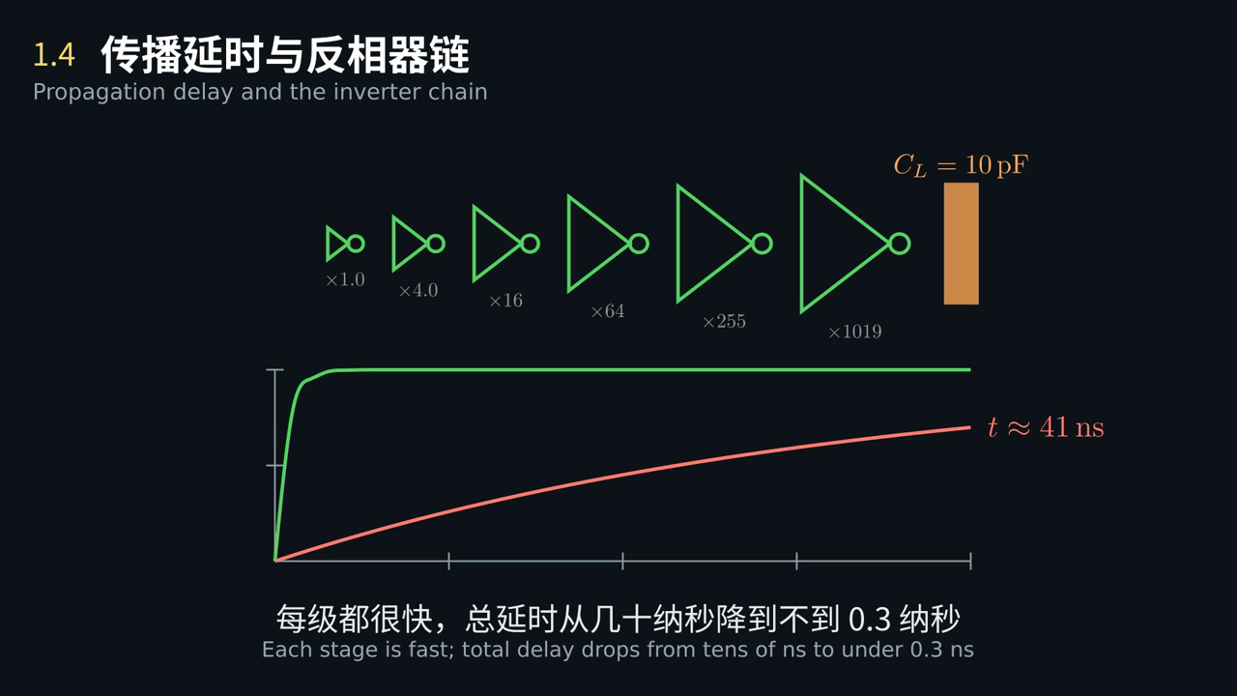
1.4 动画 Animation
一级驱动和六级驱动，延时为什么能差一百多倍？
Why can one stage and six stages differ in delay by more than a hundred times?
点击画面播放 · 中英字幕 · Click to play · bilingual captions
Notes:
播放动画，在关键画面暂停提问。
Play the clip and pause at the key frame to ask the question on the slide.

Slide 21
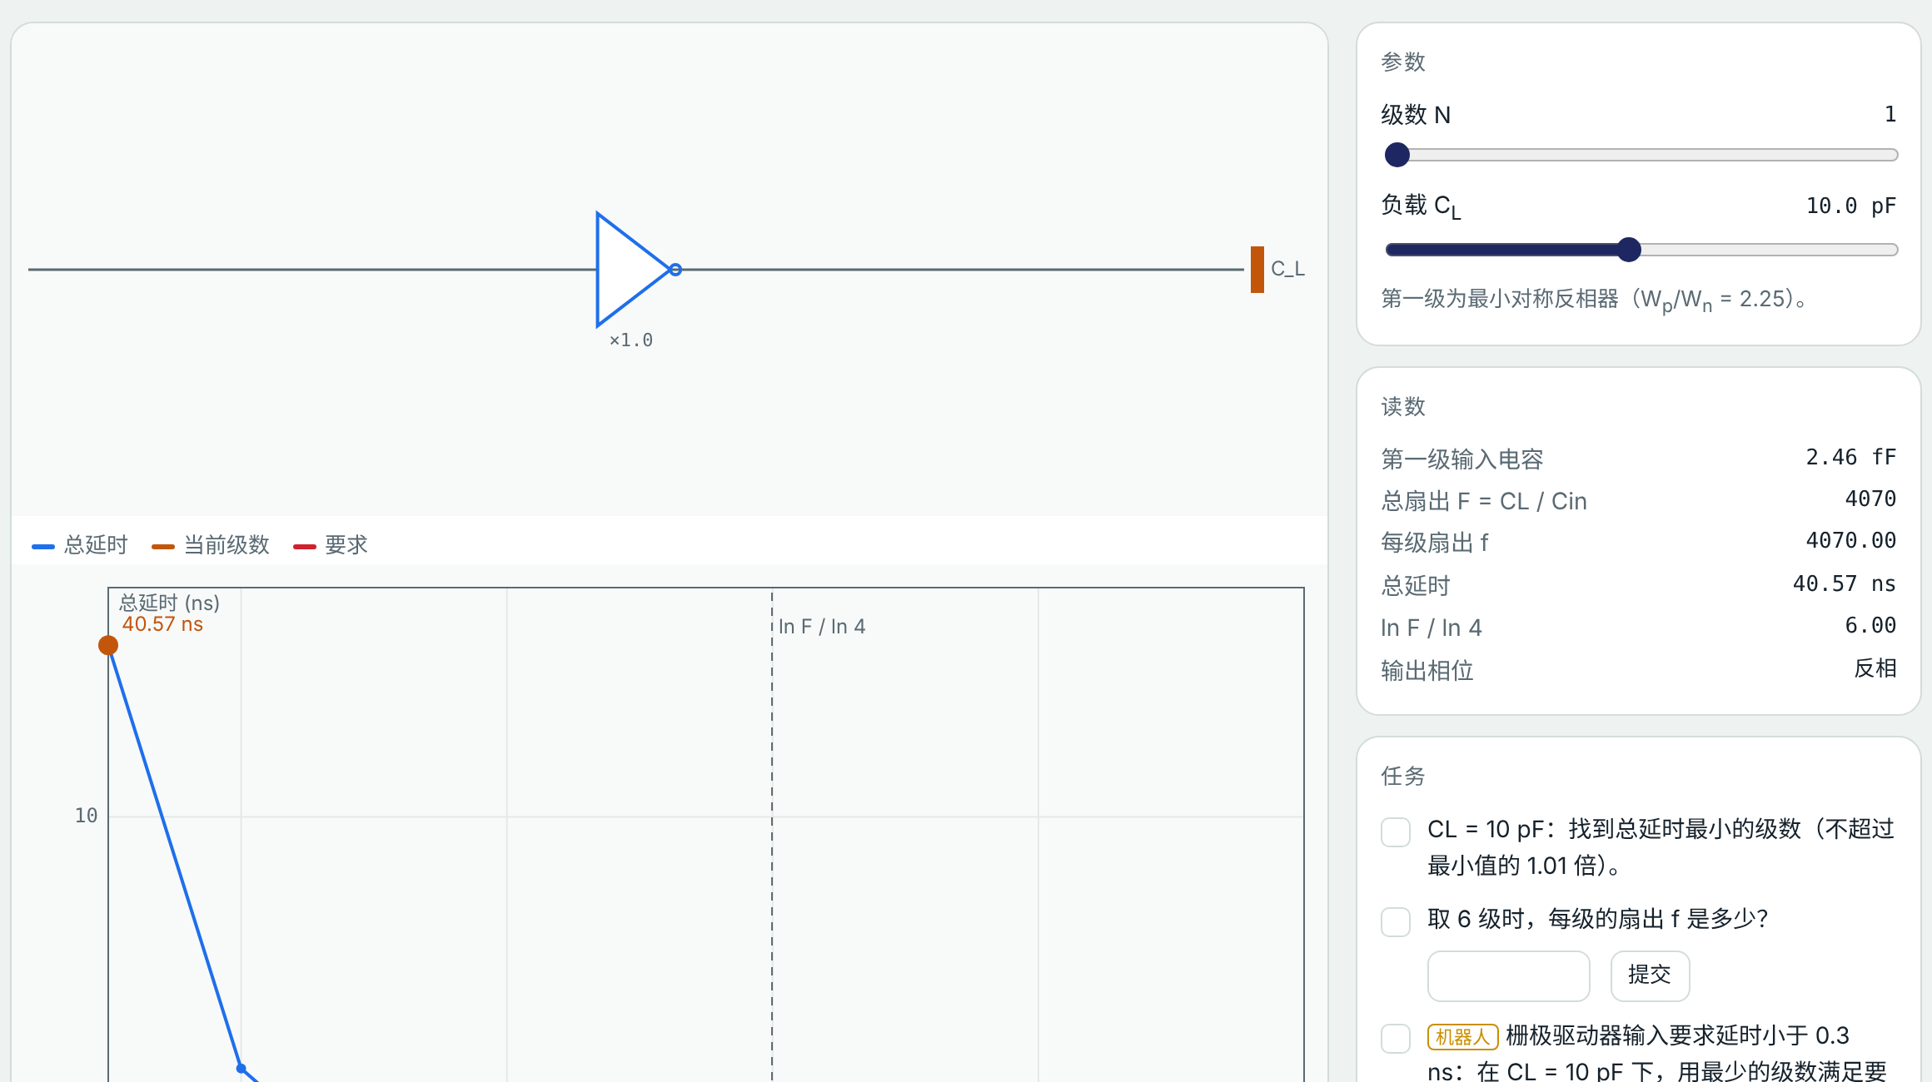
1.4 虚拟实验 Virtual lab
动手试一试：传播延时与反相器链
Try it: Propagation delay and the inverter chain
任务 Tasks
CL = 10 pF：找出延时最小的级数
CL = 10 pF: find the number of stages with the smallest delay
6 级时每级扇出 f 是多少？
What is f with 6 stages?
延时 < 0.3 ns 的最少级数
Fewest stages for a delay under 0.3 ns
打开虚拟实验 Open lab ▶
实验台中选“1.4”选项卡 · 课后按实验指导书完成实验报告
Choose tab 1.4 · write the lab report using the lab guide
Notes:
课堂投屏演示机器人任务，其余任务课后完成，并按实验指导书写实验报告。
Demonstrate the robot task in class; students finish the rest and the lab report after class.

Slide 22
1.4 回到实际问题 Back to the problem
建模求解：驱动板上的栅极驱动器
Modelling: Driving the gate driver on the board
步骤 Step | 内容 What we do
① 问题 Problem | 芯片的 PWM 输出要经焊盘、走线驱动电路板上的栅极驱动器输入，总负载约 10 pF。最小反相器直接驱动要几十纳秒，PWM 边沿被拖慢。插几级缓冲最快？ The chip’s PWM output drives pad, trace and gate-driver input, about 10 pF in all. A minimum inverter takes tens of nanoseconds, smearing the PWM edges. How many buffer stages are fastest?
② 建模 Model | 等比反相器链，第一级为最小对称反相器；负载集中为 10 pF；每级 RC 模型 Tapered chain starting from a minimum symmetric inverter; 10 pF lumped load; RC model per stage
③ 求解 Solve | F ≈ 4070，ln F / ln 4 ≈ 6.00；单级 ≈ 41 ns；6 级 f ≈ 4.0、t ≈ 279 ps；5 级 ≈ 296 ps 即满足 < 0.3 ns F ≈ 4070, ln F / ln 4 ≈ 6.00; one stage ≈ 41 ns; 6 stages f ≈ 4.0, t ≈ 279 ps; 5 stages ≈ 296 ps already meets < 0.3 ns
④ 检验 Check | 虚拟实验 1.4：CL = 10 pF，级数 1–10 扫描，对照 0.3 ns 线 Lab 1.4: CL = 10 pF, sweep 1–10 stages against the 0.3 ns line
⑤ 修正 Improve | 最优附近曲线很平：可少用一级省面积和功耗；要同相输出取偶数级；焊盘和走线电感还会带来振铃 The optimum is flat: drop a stage to save area and power; use an even count for a non-inverted output; pad and trace inductance add ringing
生活中的例子
Everyday example
搬重物接力：一人搬太慢，分几段逐级加人更快，但人太多交接也费时
Relay carrying: one person is slow, adding people stage by stage is faster, but too many hand-offs waste time
芯片设计也靠模型：先用简单模型估算，再用仿真和工艺库校准，最后指出模型的局限。
Chip design runs on models: estimate simply, calibrate with simulation and the process library, then name the limits.
Notes:
对照五步讲解，强调第⑤步：模型在哪里失效。实验报告第六部分按这五步写。数值为示意参数下的结果，以后按 SKY130 校准。
Walk through the five steps, stressing step ⑤. Section 6 of the lab report follows them. Numbers use illustrative parameters, to be calibrated to SKY130.

Slide 23
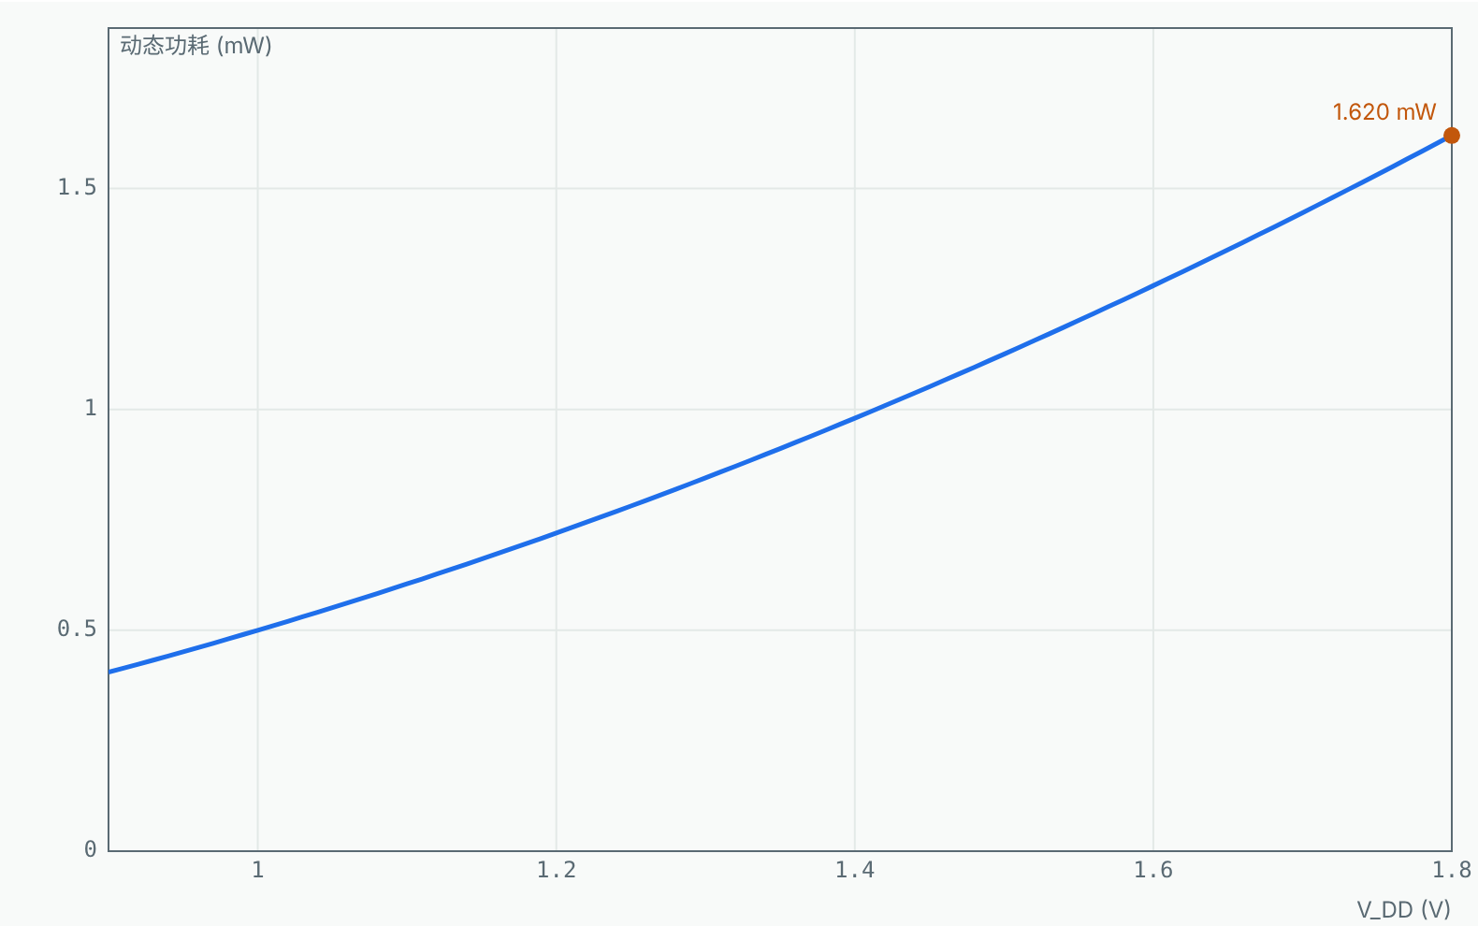
1.5 机器人问题 Robot problem
巡线小车控制芯片的功耗预算
Power budget of a line-following car controller
巡线小车的控制芯片约 1 万个门，平均每个时钟有 10% 的门翻转，时钟 100 MHz。动态功耗多大？把电压从 1.8 V 降到 1.2 V 能省多少，又要付出什么代价？
The line-following car’s controller has about 10 000 gates, 10% switching each cycle at 100 MHz. What is the dynamic power? How much does dropping from 1.8 V to 1.2 V save, and at what cost?
已知 Given
门数 N = 10 000，翻转率 α = 0.1
N = 10 000 gates, activity α = 0.1
时钟 f = 100 MHz
clock f = 100 MHz
每门负载 C = 5 fF
load per gate C = 5 fF
本节结束时，我们用建立的模型回答这个问题。 We will answer it with this lesson’s model at the end.
Notes:
先让学生估一估、讨论 2 分钟，不急于给答案。本节最后回到这一页。
Let students estimate and discuss for two minutes; return to this problem at the end.

Slide 24
1.5 概念 Concept
动态功耗：每次翻转的能量
Dynamic power: the energy per transition
0→1：电源送出 CV²，一半存进电容，一半在 PMOS 上变成热
0→1: the supply delivers CV², half stored, half burnt in the PMOS
1→0：电容里的 ½CV² 在 NMOS 上变成热
1→0: the stored ½CV² is burnt in the NMOS
动态功耗与电压平方成正比
Dynamic power scales with the square of the supply
降压使电流变小、门变慢：tp ∝ VDD / (VDD − VT)²
Lower supply means less current and slower gates: tp ∝ VDD / (VDD − VT)²
P = α · C · VDD² · f · N
Notes:
讲清公式中每个量的意义和模型的适用条件，再进入动画。
Explain each quantity and the model’s conditions before the animation.

Slide 25
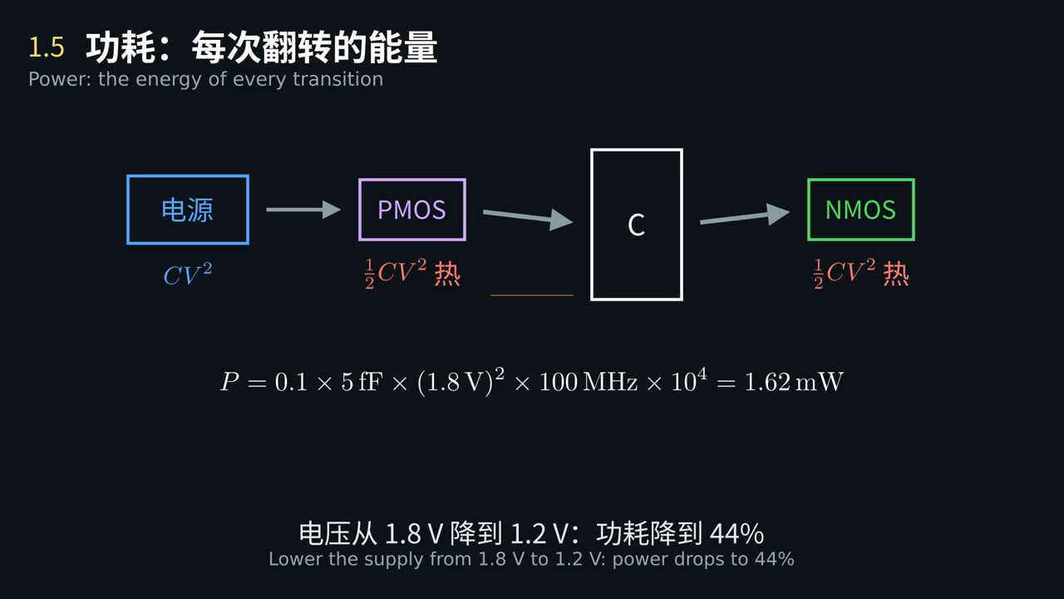
1.5 动画 Animation
电容充一次电、放一次电，电源一共送出多少能量？都去哪里了？
One charge and one discharge: how much energy does the supply deliver, and where does it go?
点击画面播放 · 中英字幕 · Click to play · bilingual captions
Notes:
播放动画，在关键画面暂停提问。
Play the clip and pause at the key frame to ask the question on the slide.

Slide 26
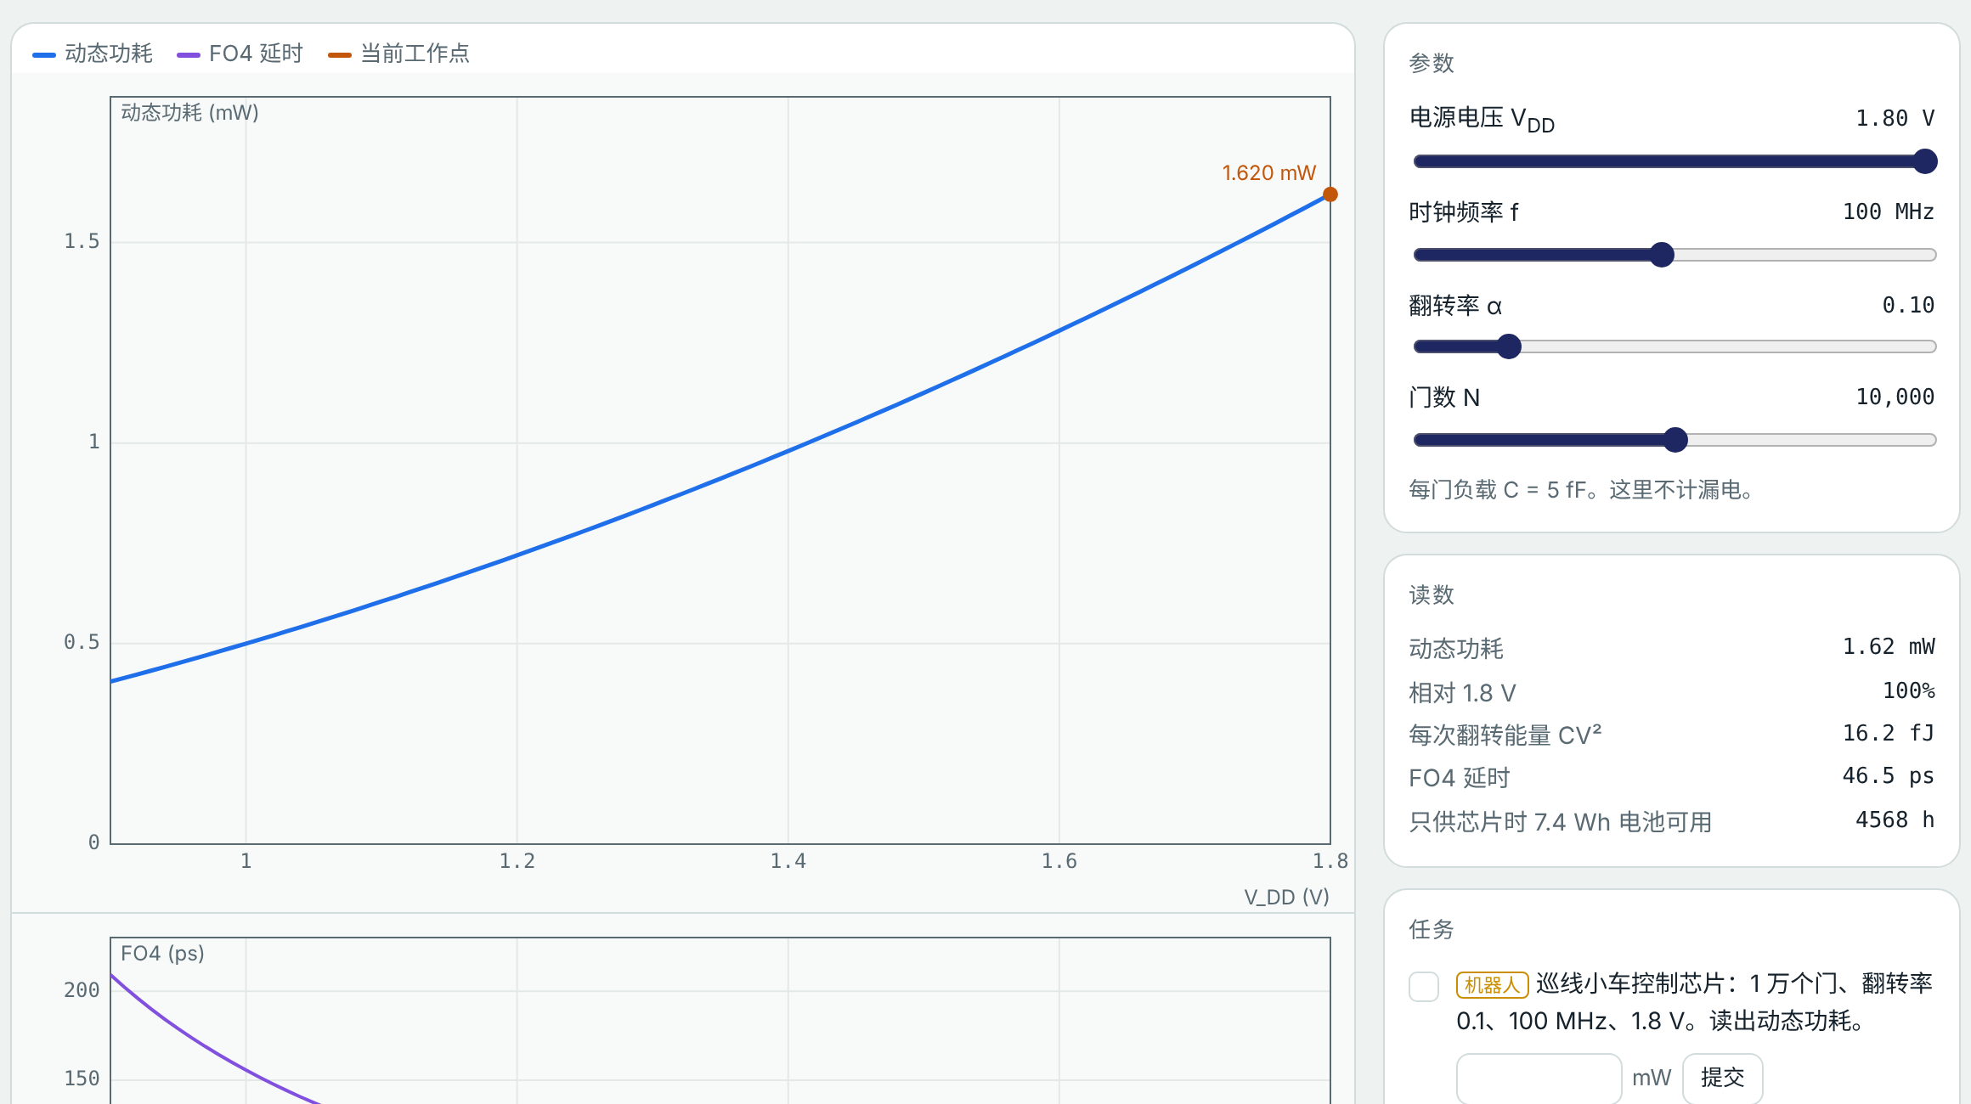
1.5 虚拟实验 Virtual lab
动手试一试：功耗
Try it: Power
任务 Tasks
读出默认设置下的动态功耗
Read the dynamic power at the default settings
电压降到 1.20 V，功耗降多少？
Lower the supply to 1.20 V: how much is saved?
FO4 ≤ 100 ps 的最低电压
Lowest supply with FO4 ≤ 100 ps
打开虚拟实验 Open lab ▶
实验台中选“1.5”选项卡 · 课后按实验指导书完成实验报告
Choose tab 1.5 · write the lab report using the lab guide
Notes:
课堂投屏演示机器人任务，其余任务课后完成，并按实验指导书写实验报告。
Demonstrate the robot task in class; students finish the rest and the lab report after class.

Slide 27
1.5 回到实际问题 Back to the problem
建模求解：巡线小车控制芯片的功耗预算
Modelling: Power budget of a line-following car controller
步骤 Step | 内容 What we do
① 问题 Problem | 巡线小车的控制芯片约 1 万个门，平均每个时钟有 10% 的门翻转，时钟 100 MHz。动态功耗多大？把电压从 1.8 V 降到 1.2 V 能省多少，又要付出什么代价？ The line-following car’s controller has about 10 000 gates, 10% switching each cycle at 100 MHz. What is the dynamic power? How much does dropping from 1.8 V to 1.2 V save, and at what cost?
② 建模 Model | 只计动态功耗，不计漏电与短路电流；所有门负载相同；翻转率取平均值 Dynamic power only, no leakage or short-circuit current; identical gate loads; average activity
③ 求解 Solve | P = 0.1 × 5 fF × 1.8² × 100 MHz × 10⁴ = 1.62 mW；1.2 V 时 0.72 mW（降 56%）；FO4 ≤ 100 ps 要求 VDD ≥ 1.21 V P = 0.1 × 5 fF × 1.8² × 100 MHz × 10⁴ = 1.62 mW; at 1.2 V 0.72 mW (56% less); FO4 ≤ 100 ps needs VDD ≥ 1.21 V
④ 检验 Check | 虚拟实验 1.5：改电压、频率、翻转率，对照功耗曲线和 FO4 延时曲线 Lab 1.5: vary supply, clock and activity against the power and FO4 delay plots
⑤ 修正 Improve | 低电压、高温时漏电不能忽略；小车上电机耗电远大于芯片，芯片省电主要延长待机和传感器节点的电池寿命 Leakage matters at low voltage and high temperature; on the car the motors dominate, so chip savings mainly extend standby and sensor-node battery life
生活中的例子
Everyday example
手机省电模式：降频、降压，代价是变慢
Phone power-saving mode lowers clock and voltage, at the cost of speed
芯片设计也靠模型：先用简单模型估算，再用仿真和工艺库校准，最后指出模型的局限。
Chip design runs on models: estimate simply, calibrate with simulation and the process library, then name the limits.
Notes:
对照五步讲解，强调第⑤步：模型在哪里失效。实验报告第六部分按这五步写。数值为示意参数下的结果，以后按 SKY130 校准。
Walk through the five steps, stressing step ⑤. Section 6 of the lab report follows them. Numbers use illustrative parameters, to be calibrated to SKY130.

Slide 28
例题 Worked example
对称反相器 Wn = 0.42 μm、Wp = 0.94 μm，驱动 4 个相同反相器（FO4）。求 tPHL。
A symmetric inverter, Wn = 0.42 μm and Wp = 0.94 μm, drives four identical inverters (FO4). Find tPHL.
IDSAT,n = ½k′n(W/L)(VDD − VT)² = 230 μA
IDSAT,n = ½k′n(W/L)(VDD − VT)² = 230 μA
Req,n ≈ ¾·VDD / IDSAT = 5.88 kΩ
Req,n ≈ ¾·VDD / IDSAT = 5.88 kΩ
Cin = (Wn + Wp)·Cg = 2.46 fF；自载 (Wn + Wp)·Cd = 1.64 fF
Cin = (Wn + Wp)·Cg = 2.46 fF; self-load (Wn + Wp)·Cd = 1.64 fF
CL = 4·Cin + 自载 = 11.47 fF；tPHL = 0.69·Req,n·CL ≈ 46.5 ps（虚拟实验 1.3 中验证）
CL = 4·Cin + self-load = 11.47 fF; tPHL = 0.69·Req,n·CL ≈ 46.5 ps (check it in lab 1.3)
Notes:
先让学生独立算 3 分钟，再展开；最后在虚拟实验 1.3 中设 Wp/Wn = 2.25、FO4 对照。
Give students three minutes, then work through it and check in lab 1.3 with Wp/Wn = 2.25 at FO4.

Slide 29
本章小结
Chapter summary
互补结构：稳态无直流通路；导通管相当于电阻 Ron
Complementary structure: no static DC path; the on transistor acts as Ron
传输特性：VM 由两管强弱比决定，噪声容限保证抗干扰
Transfer curve: VM set by the strength ratio; noise margins give immunity
延时：tp = 0.69·Req·CL；Wp/Wn = r 对称，≈ √r 最快
Delay: tp = 0.69·Req·CL; Wp/Wn = r is symmetric, ≈ √r is fastest
大负载：等比反相器链，每级扇出约 4
Large loads: a tapered chain with fan-out about 4 per stage
功耗：P = αCV²fN，降压最省电，但门会变慢
Power: P = αCV²fN; lowering VDD saves most, but slows the gates
课后：5 个虚拟实验任务 ＋ 实验报告（任选一个机器人问题）；预习第 2 章 组合逻辑门
After class: the five virtual labs + one lab report on a robot problem; preview Chapter 2, combinational gates
Notes:
回顾本章：一个反相器就包含了电平、速度、功耗三件事。后面的门电路、时序和版图都建立在这里。
Review: one inverter already contains levels, speed and power; the gates, timing and layout that follow build on this.

